Slide 1
CAR# CAR 173917546 Finding
Q1 : Anne
Q2 to Q3: Thomas
Q4 to Q5: Balina
Q6 to Q7: Jasper

Slide 2
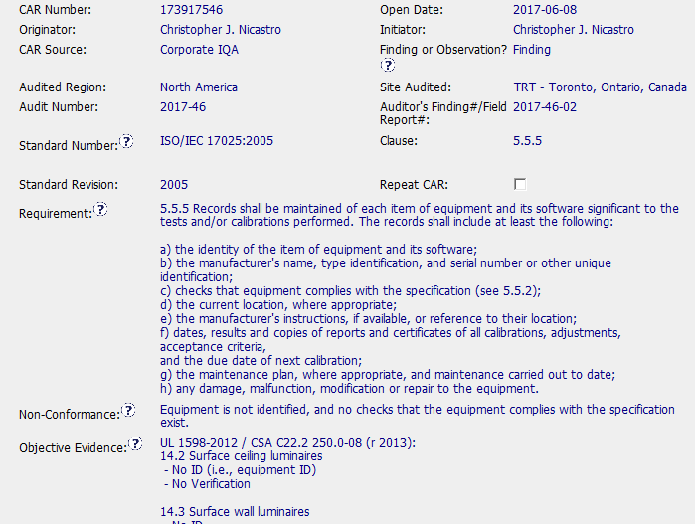
CAR 173917546 – Anne Deng

Slide 3
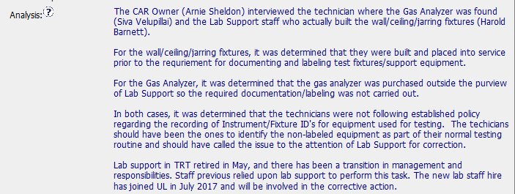

CAR 173917546 - Anne Deng
(Q1) Explain how/If the nonconformity is fully addressed in the analysis:
Yes, the analysis fully address the nonconformity that no verification & labeling were carried out for key equipment before placing into service.

Slide 4
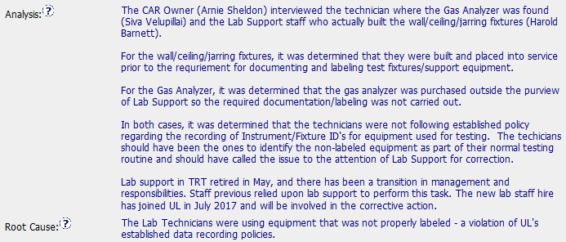

CAR 173917546 - Thomas Kestner
Additional Comment:
For root cause, we could refer to CAR FAQ 19, the root cause statement looks like restate the nonconformance, instead of finding true cause.
(Q2) Explain how/If the analysis supports the root cause statement:
Partially. Determining the root cause often requires answering a series of ‘why?’ questions and digging deep into the situation until the fundamental reason for the problem is found.
The analysis has identified lab technicians did not following SOP’s requirements to record the instrument/fixture ID, so did not find and escalate the issue to lab support; the analysis did not continue to ask ‘ why they did not follow SOP’s requirement to record?’ if no enough training regarding SOP had been provided for them, we need to find the true cause.
The analysis also has identified it is lab support’s responsibility to manage the equipment, due to lab support was retired, the equipment were not managed well as usual; the analysis did not continue to ask ‘ why the responsibility of equipment management was not taken over timely?’, so the another fundamental reason for the issue should be due to the reason of lab management, no arrangement for new staff to take on the responsibility of equipment management timely, or no backup process was set up.

Slide 5
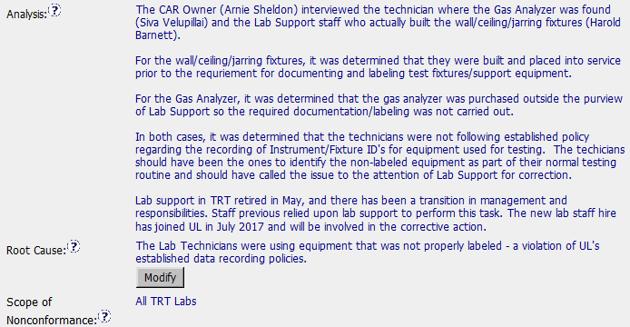

CAR 173917546 - Thomas Kestner
(Q3) Explain how/If the analysis supports the Scope of Nonconformance statement :
By referring to “analysis”, it looks like “analysis” support the “Scope of Nonconformance” statement. Due to lab support in TRT was retired, no back up was assigned to take on the responsibility for equipment management, the scope of nonconformance was applied to all TRT labs.

Slide 6
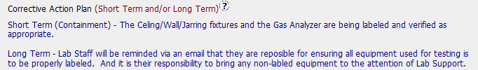

CAR 173917546 - Balina Ling
(Q4) Explain why/If the Corrective Action Plan will prevent the recurrence of the nonconformity:
Partially.
A. For the issue of no equipment verification before placing into service, no corrective action plan was identified to prevent the recurrence of the nonconformity.
B. For the issue of Equipment were not identified, due to root cause was not found, the identified corrective action plan can not prevent the recurrence of the nonconformity.
Based on the analysis for root cause, corrective action plan should be:
The lab management should provide training, evaluation & qualification for new lab supports, as so they can take on the responsibility of equipment management ASAP; and set up back up process, so as to prevent the recurrence of the nonconformity.
The lab management also should provide training for lab technicians regarding SOP’s requirements.

Slide 7

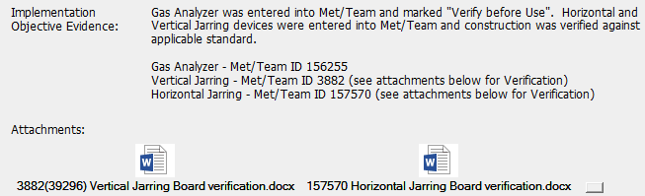
CAR 173917546 – Balina Ling
(Q5) Explain how/If the containment milestone “stopped the bleeding”:
Partially.
A. At containment, it identified nonconformity equipment are being labeled and verified, but confirmed at milestone, no enough evidences were provided to demonstrate all nonconformity equipment had been labeled and verified.
B. Additionally, due to the scope of nonconformance was applied to all TRT Labs, CAR Owner did not audit for the other equipment of TRT labs to see if existing same issues, and correct them if any.

Slide 8
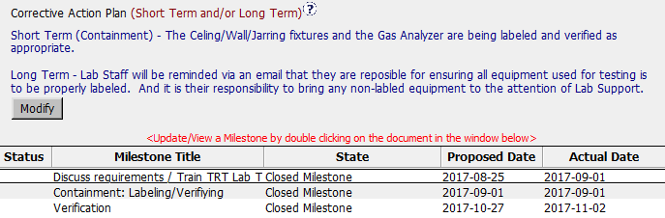

CAR 173917546 – Jasper Wu
(Q6) Confirm that/If all corrective action milestones are aligned to each item of the corrective action plan:
Partially. Corrective action milestones are partially aligned to each item of the corrective action plan, due to Verification milestone is available, but verification action was missed in corrective action plan.
Another, the sequence of implement date was error, containment milestone should be conducted before the long term milestone.

Slide 9
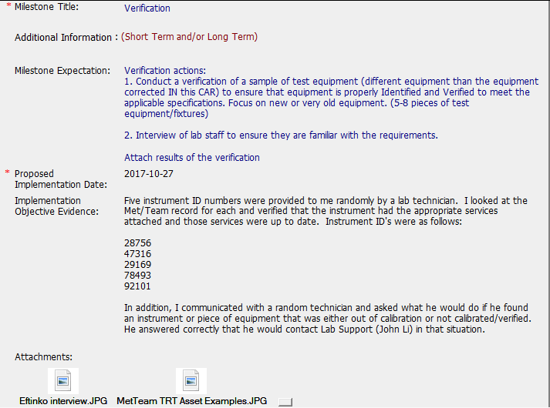

CAR 173917546 – Jasper Wu
(Q7) Explain how/If the verification milestone confirmed the effective implementation of the corrective action plan.
Yes, CAR owner had randomly selected five instruments to confirm if they had been labeled and verified to meet the specification, and randomly interviewed lab staff to confirm if he is familiar with the requirements.
But suggest to add the comments that ‘After verification, all nonconformity equipment were met the specification, no track back is needed.

Slide 10
CAR 173917546 – CAR Review Criteria Check
CAR Review Criteria | Fully | Partially | Not at all | N/A
•Is the nonconformity fully addressed in the analysis? | √
•Does the analysis support the root cause statement? |  | √
•Does the analysis support the Scope of Nonconformance statement | √
•Will the Corrective Action Plan prevent recurrence of the nonconformity? |  | √
•Did the containment milestone “stop the bleeding”? |  | √
•Are corrective action milestones aligned to each item of the corrective action plan? |  | √
•Did the verification milestone confirm the effective implementation of the corrective action plan? | √

Slide 11
Finding CAR # 173917546

Slide 12
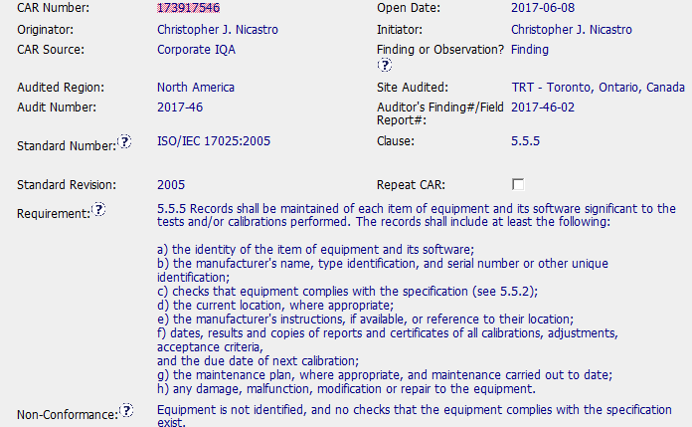
CAR review - 173917546

Slide 13
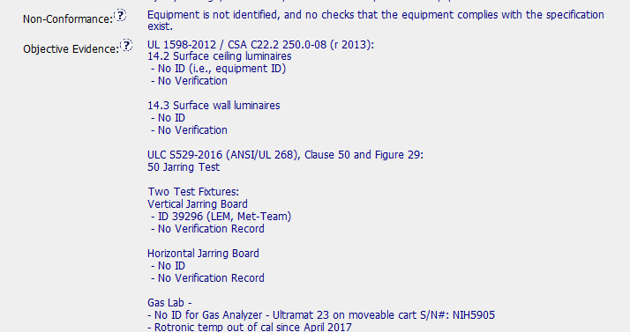
CAR review - 173917546

Slide 14
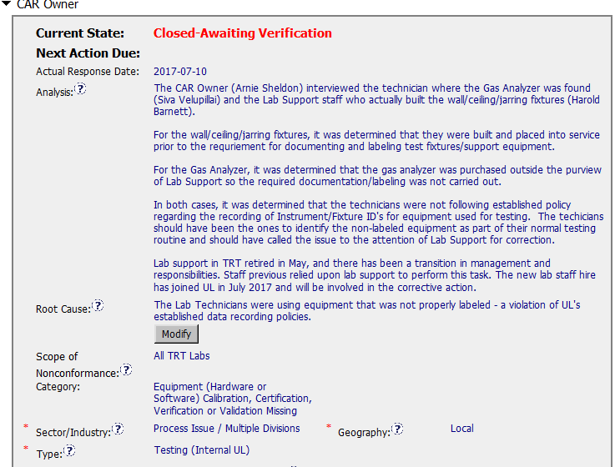
CAR review - 173917546

Slide 15
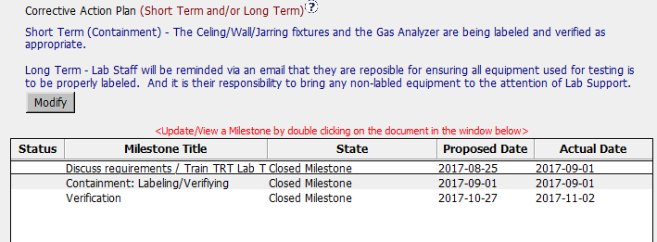
CAR review - 173917546

Slide 16
CAR Review - 173917546
Is the nonconformity is fully addressed in the analysis?
Analysis did not really review the reasons why the equipment lacked required markings.
Does the analysis support the root cause statement?
Analysis did not review the reason why unmarked equipment was being used or verified.
Does the analysis support the Scope of Nonconformance statement?
Yes
Will the Corrective Action Plan will prevent the recurrence of the nonconformity?
Does not assure that equipment will not be purchased or commissioned for use with proper ID.

Slide 17
CAR Review - 173917546
Did the containment milestone “stopped the bleeding”?
Milestone to properly label and verify equipment was set almost 3 months after the finding. Not using equipment until verified would have stopped the bleeding.
Did all corrective action milestones are aligned to each item of the corrective action plan?
The milestones are in reverse to what is stated in the corrective action plan.
Did the verification milestone confirm the effective implementation of the corrective action plan?
Partially. A tour of the lab should have occurred to ensure proper labelling of equipment.

